Slide 1



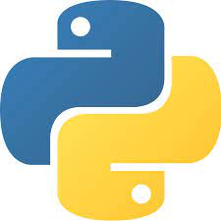
ML MODEL DEPLOYMENT
Fenyx academy

Slide 2
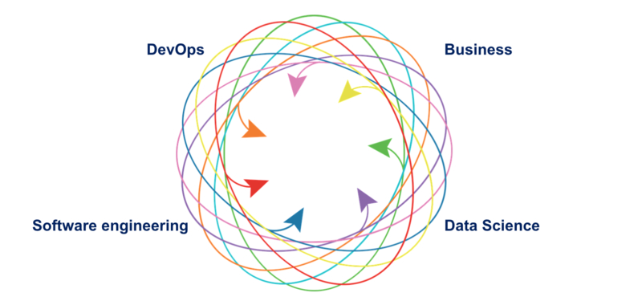
Why are ML Systems Hard?
x
Entanglement: If we have an input feature which we change, then the importance, weights or use of the remaining features may all change as well (or not). This is also referred to as the “changing anything changes everything” issue, and means that machine learning systems must be designed so that feature engineering and selection changes are easily tracked.
Data Dependencies: In a ML System, you have two equally consequential components: code and data. However, some data inputs are unstable, perhaps changing over time. You need a way to understand and track these changes in order be able to fully understand your system.
Configuration: Especially when models are constantly iterated on and subtly changed, tracking config updates whilst maintaining config clarity and flexibility becomes an additional burden.
Data and Feature Preparation: If left unchecked, vast webs of of scripts, joins, scrapes and intermediate output files can form around various steps of data munging and feature engineering. Unpicking or maintaining such “glue code” is a deeply frustrating and error-prone task for even an experienced software developer.
Detecting Model Errors: There are plenty of things that can go wrong in machine learning applications that will not be picked up by traditional unit/integration tests. Deploying the wrong version of a model, forgetting a feature, and training on an outdated dataset are just a few examples.
Separation of Expertise: Machine learning systems require cooperation between multiple teams, which can result in no single team or person understanding how the overall system works, teams blaming each other for failures, and general inefficiencies.
ML Systems Span Many Teams (could also include data engineers, DBAs, analysts etc.):

Slide 3
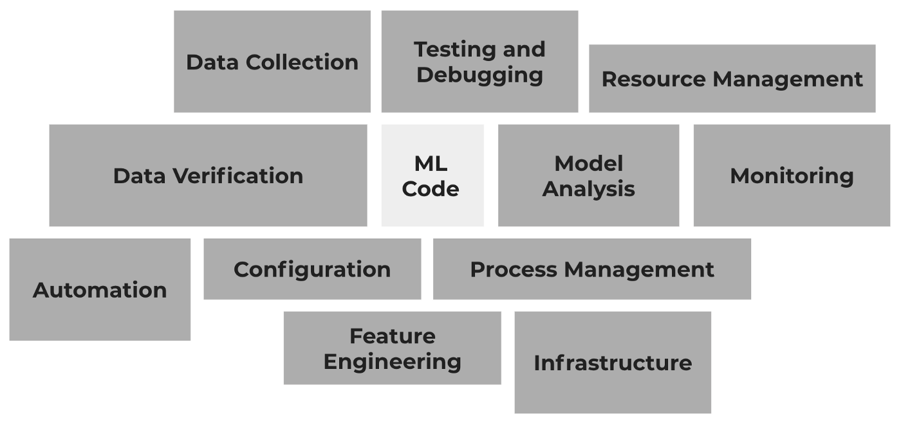
Why are ML Systems Hard?
Only a small fraction of real-world ML systems is composed of the ML code

Slide 4
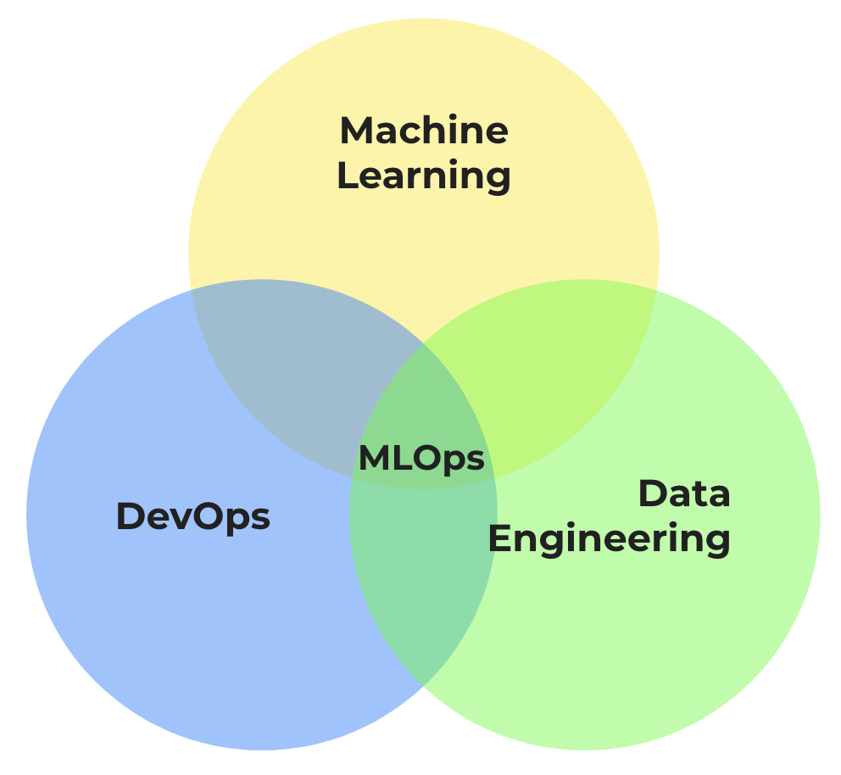
Why are ML Systems Hard?
MLOps is basically:
The extension of the DevOps methodology to include Machine Learning, Data Science and Data Engineering assets as first-class citizens within the DevOps ecosystem
This basically means that as ML and AI propagate into more robust software products, we need to establish best practices and tools to test, deploy, manage, and monitor ML models in real-world production (A good and robust MLOps architecture).
MLOps then can be seen as different available capabilities and levels of maturity in any organization that helps us reduce the deployment gap.
A Venn diagram of the different areas that compose MLOps

Slide 5
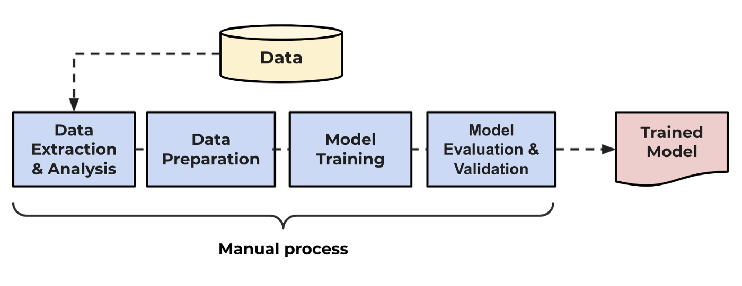
Level 0: No MLOps
The MLOps maturity model is divided into five levels:
Level 0: No MLOps
At this initial level mostly everything is done manually: data gathering, builds and deployments, training, and testing of the model. There is no centralized tracking of model performance and it is difficult to manage full machine learning model lifecycle. The teams of data scientists, data engineers, and software engineers are siloed and releases are painful. little or no feedback and monitoring during post-deployment.

Slide 6
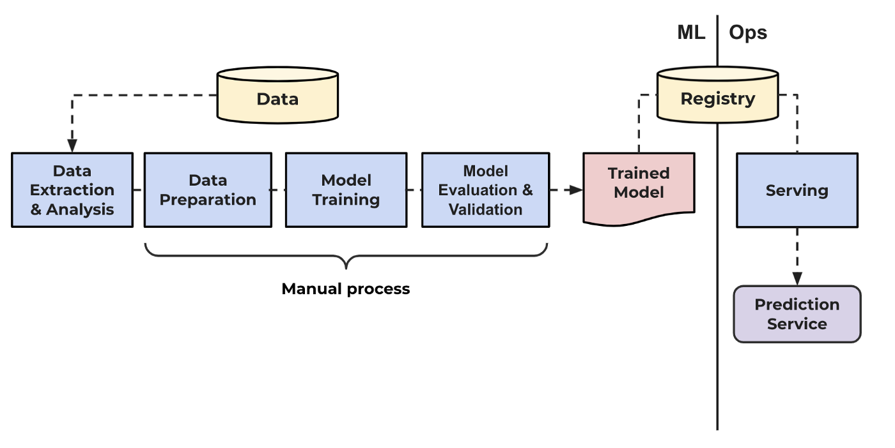
Level 1: DevOps no MLOps
On level 1 a data pipeline gathers data automatically but manual builds, training, and testing of the model are still common for the data science team. Ops is introduced and releases are automated, a prediction service for serving the model is enabled by the software development team.

Slide 7
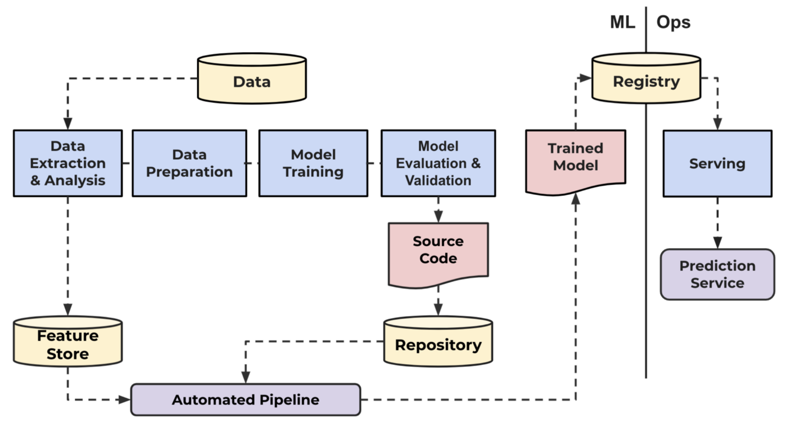
Level 2: Automated Training
On level 2 of maturity, a data pipeline gathers data automatically, code changes and experiments in training are tracked in a repository, training code and models are version controlled, an automated pipeline is introduced for automatic training taking features from a recently enabled feature store. Changes and experiments are tracked in a repository. Teams of data engineering and data scientist start working closer together for automatization.

Slide 8
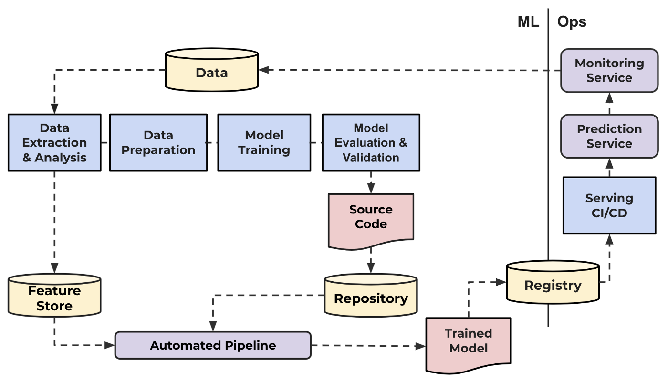
Level 3: Automated Model Deployment
On level 3, model releases are automated and managed by pipelines. A monitoring service is enabled for gathering and providing feedback into the production systems. Automated releases enable the opportunity of running and tracking A/B testing for production models. Full traceability and reproducibility are now achievable since the data extraction all the way to model performance. Teams start working closely.

Slide 9
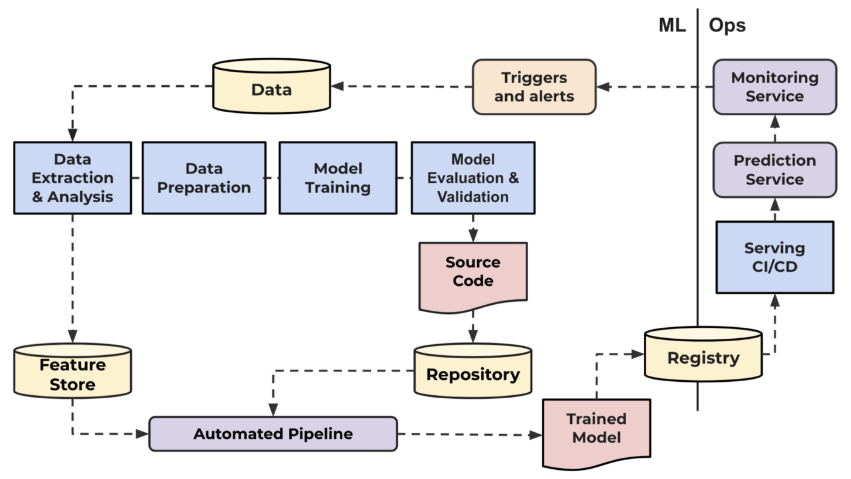
Level 4: Full MLOps Automated Retraining
Finally, in level 4, the process is fully automated, monitored, and alerted. Retraining is triggered with production metrics and alerted on any potential problems. Experiments are regular and A/B testing decides on model deployment. Testing best practices are introduced. Teams work in harmony.

Slide 10
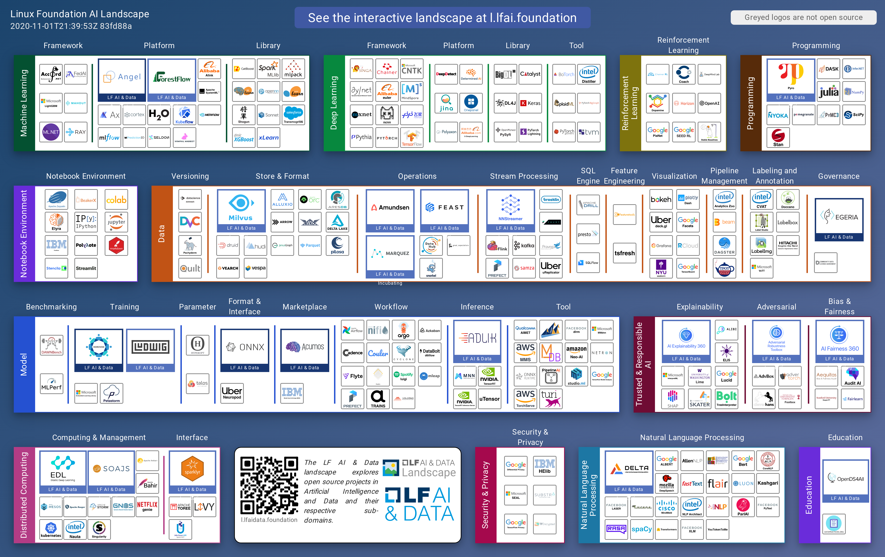
MLOps

Slide 11

Be a MLOps star…
It’s a big challenge in both raw performance and management rigor. Data sets are huge, growing, and can change in real-time. AI models require careful monitoring by cycles of experiments, tuning, and retraining to maintain high accuracy.
On average, 80% of models created with the intention of implementation are never implemented (Why do 87% of data science projects never make it into production?). In addition, a model typically takes six to eight months to implement. If you implement a model that was created six to eight months ago, that model may already be obsolete. No worries! just let’s do our best as part of MLOps always!

Slide 12
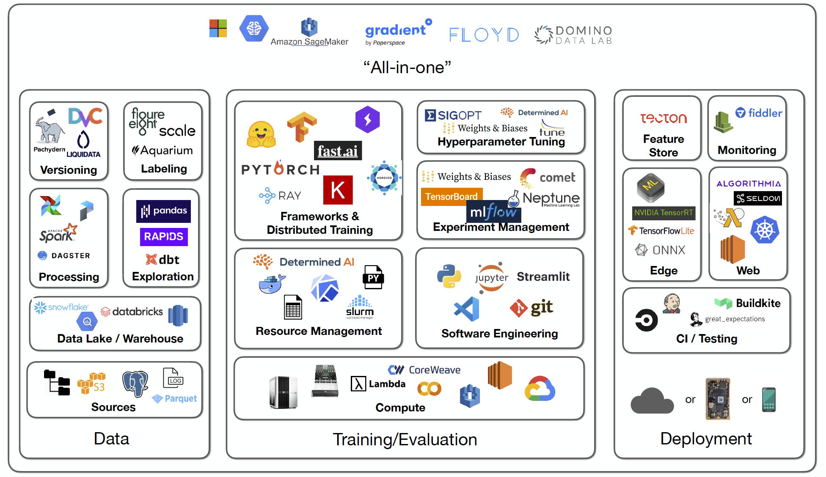
ML Deployment system

Slide 13
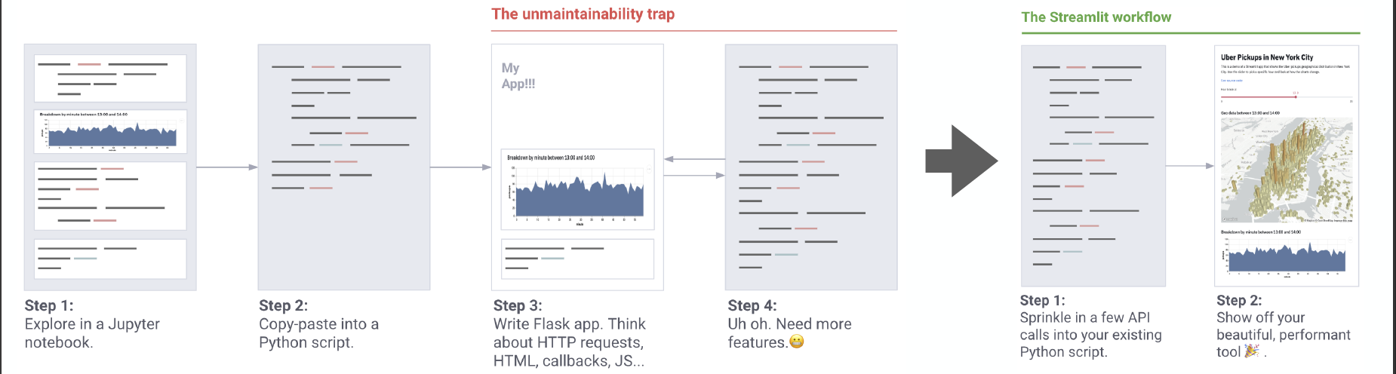
ML Deployment system

Slide 14
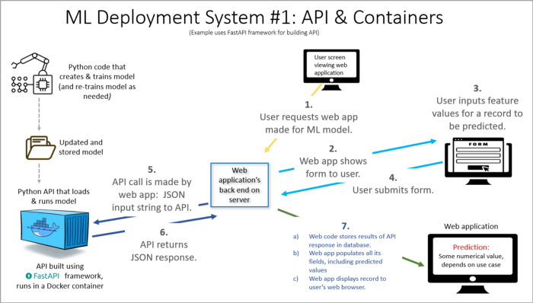
ML Deployment system

Slide 15
ML Deployment system
Load and Check Data
Variable Description
Univariate Variable Analysis
Categorical Variable
Numerical Variable
Basic Data Analysis
Outlier Detection
Missing Value
Find Missing Value
Fill Missing Value
Visualization
Feature Engineering
Modeling
Train - Test Split
Simple Logistic Regression
Hyperparameter Tuning -- Grid Search -- Cross Validation
Ensemble Modeling
Prediction and Submission
Save the model to disk
Step 1

Slide 16
ML streamlit Deployment
pip install streamlit
Write Python code
Online /Batch mode
Read the streamlit docs (https://docs.streamlit.io/)
Sign up streamlit Cloud (https://streamlit.io/cloud)
Planing your ML project installation
File Structure
Requirement.txt
Preprocessing.py (Data Preprocessing file)
Web_deploy.py (main file)
Best model *.sav file
Your company logo etc…
Install your local computer and test all functions
Create your project Github Repo and upload all necessary files
Sign-in Streamlit Cloud
Create Your app
Connect your github repo from streamlit deploy tools
Choose your master branch
Choose your main file
Test your App
Step 2

Slide 17
ML HEROKU Deployment
pip install streamlit
Write Python code
Online /Batch mode
Read the streamlit docs (https://docs.streamlit.io/)
Sign up Heroku (https://www.heroku.com/)
Planing your ML project installation
File Structure
Requirement.txt
Setup.sh (Heroku setup installation file)
Procfile (Heroku app starter file)
Preprocessing.py (Data Preprocessing file)
Web_deploy.py (main file)
Best model *.sav file
Your company logo etc…
Install your local computer and test all functions
Create your project Github Repo and upload all necessary files
Sign-in Heroku Cloud
Create Your app
Connect your github repo from Heroku deploy tools
Choose your master branch
Choose your main file
Test your App
Step 3

Slide 18

ML Deployment examples
https://fenyx-app.herokuapp.com/
https://share.streamlit.io/secedit/fenyx_ml/main/web_deploy.py
https://github.com/secedit/Fenyx_ML

